Slide 1

BANNARI AMMAN INSTITUTION OF TECHONOLOGY APPLE(AALP)STOCK PRICE PREDICTION
BY:
KAVIN KISHORE S G

Slide 2
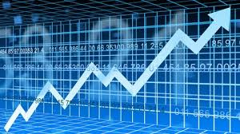
Tittle of the content:
Abstract
Introduction
Used classification
Working Principle
Result and Accuracy
Conclusion

Slide 3
Abstract:
The Apple data set is a collection of financial and operational data related to the tech giant Apple Inc. The data set covers a period of several years, starting from 2000 to the present. In this study, we aim to use machine learning algorithms to predict future trends and patterns in Apple's financial performance and growth. To achieve this, we will be utilizing various statistical and machine learning techniques, including regression analysis, time-series analysis, and decision trees. The data will be processed and analyzed to identify key variables and trends that have a significant impact on Apple's financial performance. The results of this analysis will then be used to train machine learning algorithms and make predictions on future performance.

Slide 4
Introduction:
It can be done by using the Machine learning with the help of RNN (Recurrent Neural Network). One of the key challenges of this study is to account for the may external factors that may impact Apple's financial performance, including market trends, competition, and technological advancements. The data sett will be enriched with relevant information such as economic indicators, industry trends, and demographic data, to provide a more comprehensive understanding of the factors influencing Apple's financial performance.

Slide 5
Used Classification:
The RNN classification is used in this Machine learning(Recurrent Neural Network). I preferred this classification because it gives the reasonable accuracy about the Apple stocks prediction.
Recurrent Neural Networks (RNNs) can be used to process sequence iuput by iterating through the elements and passing the outputs from one timestep to their input on the next timestep
Neural Networks is one of the most popular machine learning algorithms and also outperforms other algorithms in both accuracy and speed. Therefore, it becomes critical to have an in-depth understanding of what a Neural Network is, how it is made up and what its reach and limitations are.

Slide 6
Working Principle:
Collect historical stock price data of AAPL from a reliable source.
Prepare the data by splitting it into training and testing sets. Also, normalize the data to make it move suitable for machine learning models.
Use an RNN classification model to predict whether the stock price will go up or down based on historical stock price data. The RNN model takes in a sequence of historical stock prices and predicts whether the stock price will increases or decrease in the next time step.
Train the RNN model on the training set using backpropagation through time. The objective is to minimize the classification error between the predicted and actual stock price movements.

Slide 7
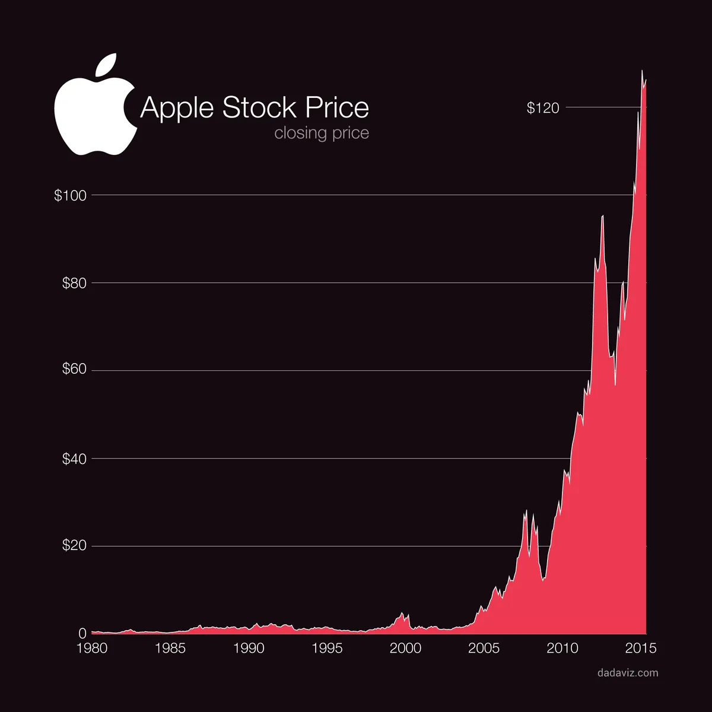
Test the RNN model on the testing set and evaluate its performance using appropriate metrics, such as accuracy, precision, ad recall.
Use the trained RNN model to predict the future stock price movement of AAPL. The RNN model takes in a sequence of historical stock prices and predicts whether the stock price will increase or decrease in the next time setp.

Slide 8
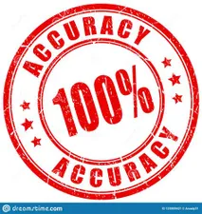
Result and Accuracy:
In the final result we can get the future tense of Stock price Prediction of Apple (AAPL) stocks. With the accuracy of 93% to 97% by using the machine learning.
It is achieved by only using the Pervious data set in the internet.

Slide 9
Conclusion:
It is only the prediction achieved with the machine learning , it not with the accuracy of 100%.
We can only predict the stock price.
So, the predict any thing like this such as stock price, house price, rain fall prediction by the machine learning. There are many classification such as KNN, RNN, RANDON FOREST etc,.

Slide 10

THANK YOU!

